Slide 1
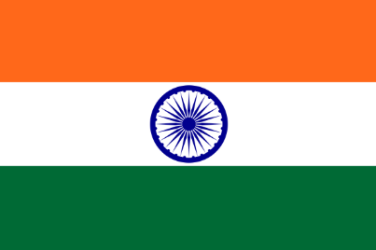
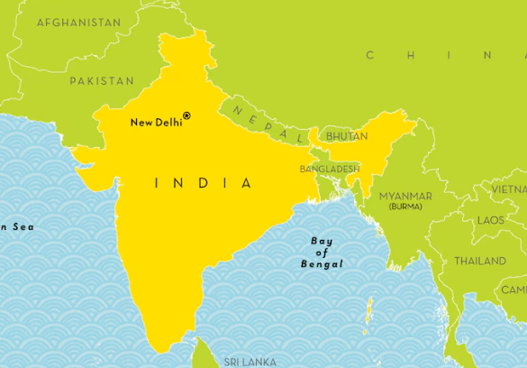

Language of the month
January - Hindi
Hindi is mainly spoken in India, particularly in the northern and central "Hindi Belt" (states like Uttar Pradesh, Bihar, Rajasthan, Delhi, etc.). Serving as an official language alongside English for the Indian Union, and is also a significant language in Nepal, Fiji, and among Indian diaspora communities worldwide.

Slide 2
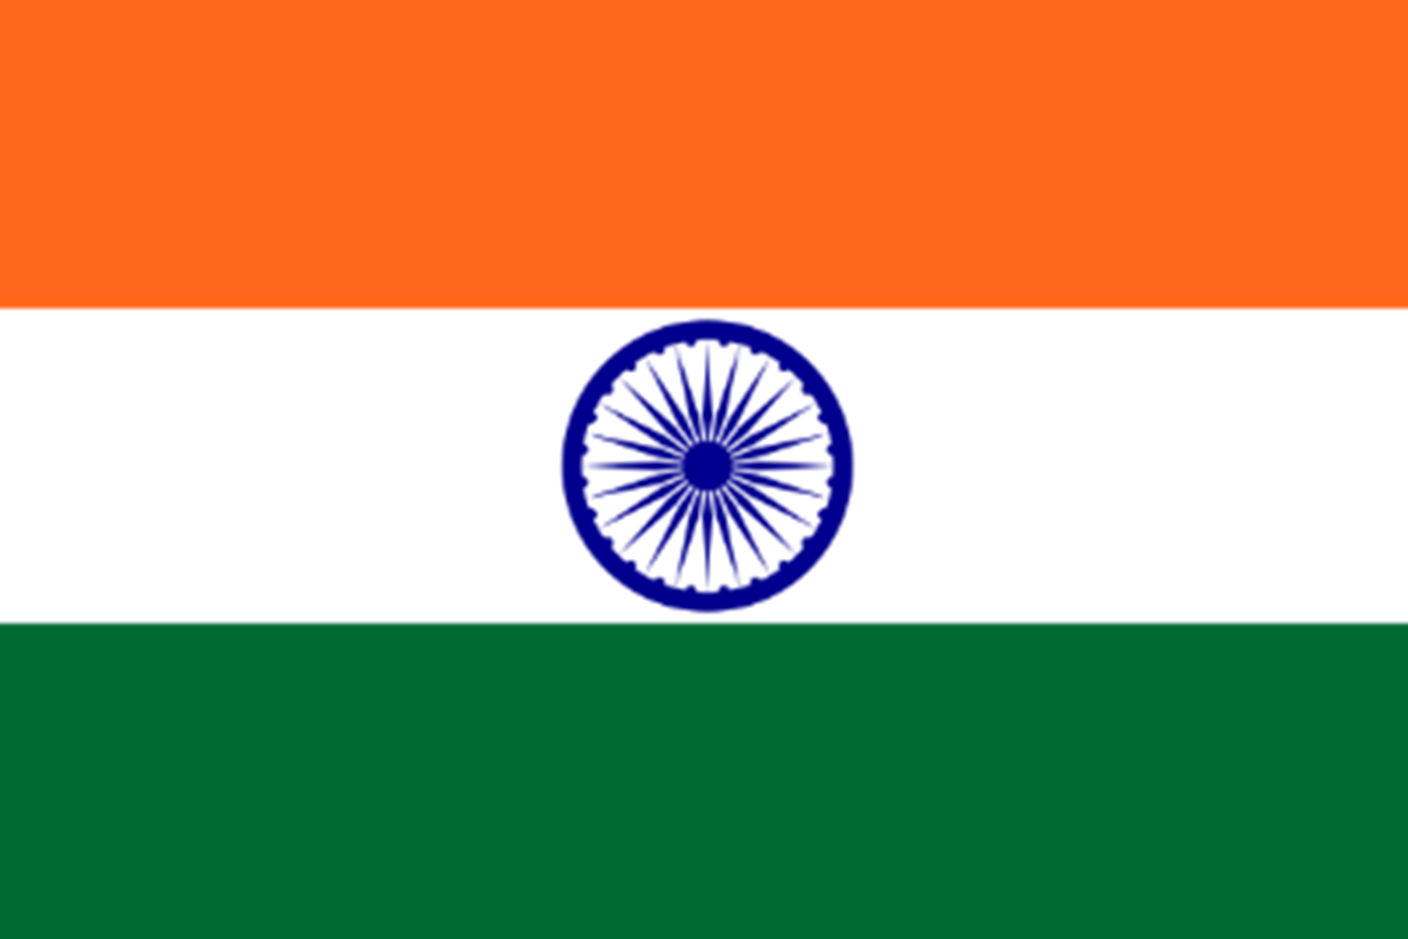

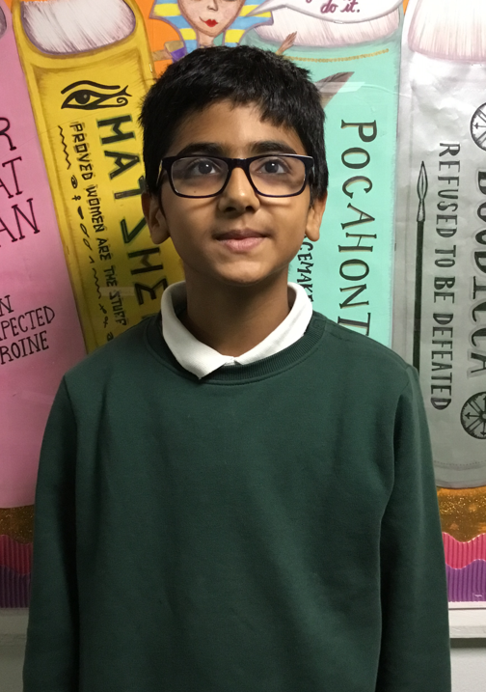
My name is Ansh.
Mera naam Ansh hai.
I can speak Hindi and English.
Mein Hindi aur English bhol sakta hu.
January - Hindi
Language of the month
I like to play guitar.
Merekol guitar baja na acha lagta hai.
I like to eat halwa!
Merekol halwa khaana acha lagta hai.

Slide 3

रजिस्टर rajistar - The Register
महोदया
शुभ दोपहर
shubh dopahar mahodaya
Hindi | English
सुप्रभात suprabhaat | Good morning
महोदया mahodaya | Madam
महोदय mahoday | Sir
शुभ दोपहर shubh dopahar | Good afternoon
नमस्ते namaste | Hello
सुप्रभात सर
suprabhaat sar
January - Hindi
सुप्रभात महोदया
suprabhaat mahodaya
Language of the month
शुभ दोपहर सर
shubh dopahar sar

Slide 4
रंग rang – Colours
آनीला
neela
लाल
laal
पीला
peela
January - Hindi
Language of the month
हरा
hara
नारंगी
naarangee
Introduction to colours: https://www.youtube.com/watch?v=4HNP3ZIarQw

Slide 5

दिन का खाना din ka khaana – Lunch
हरा धन्यवाद
hara dhanyavaad
कौन सा रंग?
kaun sa rang?
कृपया नारंगी
krpaya naarangee
कृपया पीला
krpaya peela
January - Hindi
Language of the month
Hindi | English
कृपया krpaya | please
धन्यवाद dhanyavaad | thank you
कौन सा रंग? kaun sa rang? | Which colour?
पैक दोपहर का भोजन paik dopahar ka bhojan | packed lunch
नीला धन्यवाद
neela dhanyavaad
कृपया लाल
krpaya laal

Slide 6
Good morning
सुप्रभात
suprabhaat
Thank you
धन्यवाद
dhanyavaad
Yes
हाँ
haan
Please
कृपया
krpaya
Hello
नमस्ते
namaste
Sorry
क्षमा मांगना
shama maangana
Well done बहुत अच्छा
bahut acha
January - Hindi
Language of the month
Good afternoon
शुभ दोपहर
shubh dopahar
Goodbye
अलविदा
alvida
No
नहीं
nahin

Slide 7

One
एक
ek
Three
तीन
theen
Five
पाँच
paanch
Two
दो
do
Four
चार
chaar
Six
छह
chai
January - Hindi
Eight
आठ
aath
Language of the month
Ten
दस
das
Seven
सात
saat
Nine
नौ
nau
Numbers 1-10: https://www.youtube.com/watch?v=ojykn5BE4cA&t=82s

Slide 8
Useful websites:
Facts:
https://www.kids-world-travel-guide.com/india-for-kids.html
https://kids.nationalgeographic.com/geography/countries/article/india
Late Mangeshkar was an Indian playback singer and occasional music composer. She is considered to be one of the greatest and most influential singers of the Indian subcontinent. She contributed to the Indian music industry in a career spanning eight decades that gained her honorific titles such as the "Queen of Melody" and "Voice of the Millennium”.
https://www.youtube.com/watch?v=-NCdeldQLFc
https://www.youtube.com/watch?v=tqHm_IbdTO4&list=RDtqHm_IbdTO4&start_radio=1
Arijit Singh is an Indian playback singer, composer, music producer and instrumentalist. A leading figure in contemporary Hindi film music, he is the recipient of two National Film Awards and eight Filmfare Awards. He features in Ed Sheeran’s song ‘Sapphire’:
https://www.youtube.com/watch?v=NzWkopFJuSw
January - Hindi
Language of the month

