Slide 1
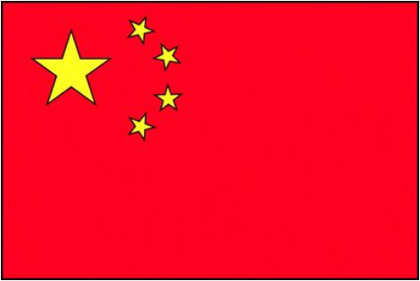
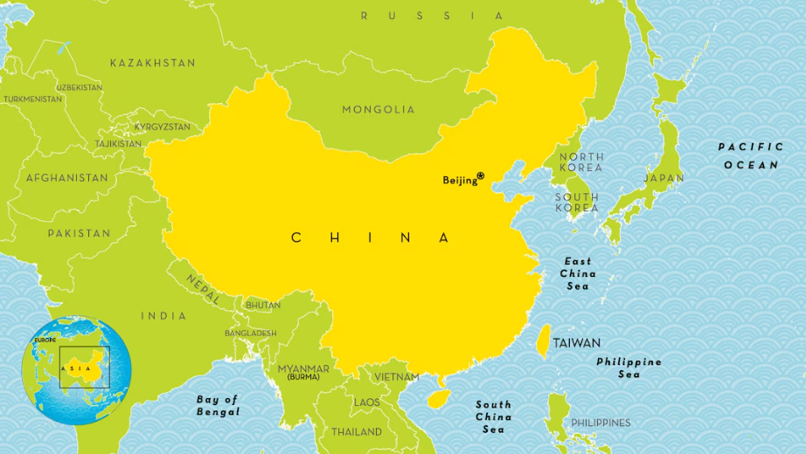

Language of the month
February - Mandarin
Mandarin Chinese is a language spoken by many people. It is mainly spoken in China and Taiwan, where it is the main language. People also speak Mandarin in Singapore, and many families around the world use it too. Children in many countries learn Mandarin at school, and it is even used in important meetings around the world.

Slide 2
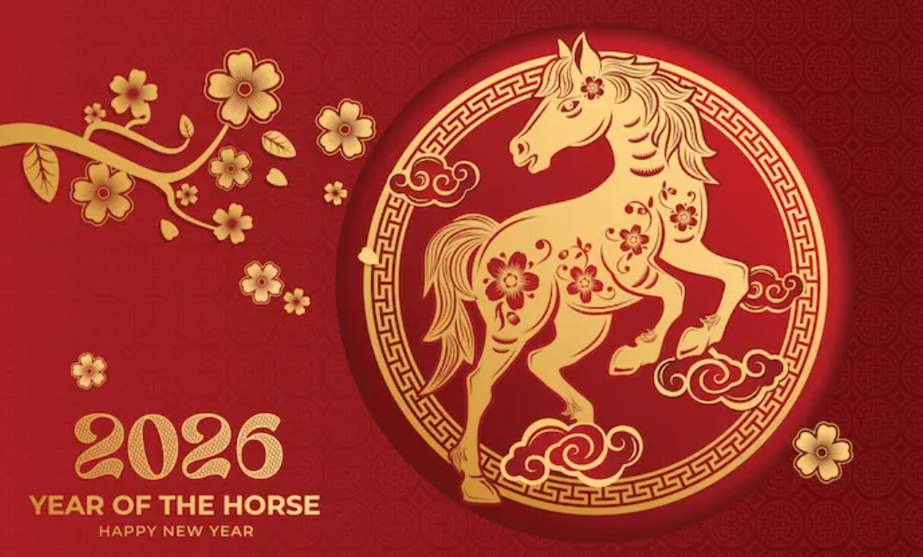

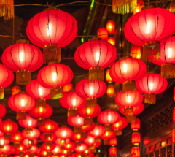
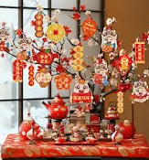
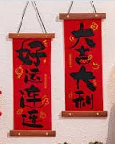
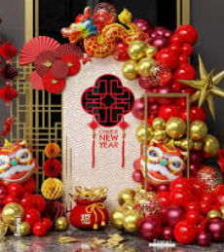
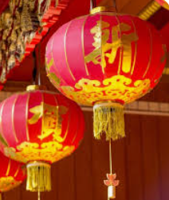
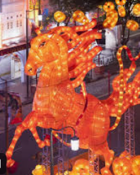
Chinese New Year is celebrated worldwide each January or February. This year brings us the Year of the Horse, commencing February 17, 2026.
Also called the Spring Festival (春节 Chūnjié), Chinese New Year celebrates the beginning of the Chinese year based on the traditional Chinese Lunisolar calendar and officially ends 15 days later with the Lantern Festival (元宵节 Yuánxiāo jié).
Chinese New Year
February 17th 2026
Lunar New Year: https://www.bbc.co.uk/teach/school-radio/articles/zp993j6
Chinese New Year: https://www.globetrottinkids.com/chinese-new-year-resources-activities/
Celebrating Chinese and Lunar New Year 2026: https://www.bbc.co.uk/cbeebies/watch/chinese-new-year
Cbeebies, telling of the Zodiac story using shadow puppets: https://www.youtube.com/watch?v=eVClAj8q_lY

Slide 3

登记册 Dēngjì cè - The Register
早上好女士
Zǎoshang hǎo nǚshì
早上好，先生。
Zǎoshang hǎo, xiānshēng
Mandarin | English
早上好 Zǎoshang hǎo | Good morning
女士 Nǚshì | Madam
先生 Xiānshēng | Sir
下午好 Xiàwǔ hǎo | Good afternoon
你好 Nǐ hǎo | Hello
February - Mandarin
先生下午好
Xiānshēng xiàwǔ hǎo
Language of the month
下午好女士
Xiàwǔ hǎo nǚshì

Slide 4
颜色 Yánsè – Colours
آ蓝色的
Lán sè de
红色的
Hóngsè de
黄色的
Huángsè de
February - Mandarin
Language of the month
绿色的
Lǜsè de
橙子
Chéngzǐ
Introduction to colours: https://www.youtube-nocookie.com/embed/THe1vmdR10o?playlist=THe1vmdR10o&autoplay=1&iv_load_policy=3&loop=1&start=2

Slide 5
午餐 Wǔcān – Lunch
绿色谢谢
Lǜsè xièxiè
哪种颜色？
Nǎ zhǒng yánsè?
请橙色
Qǐng chéngsè
请黄色
Qǐng huángsè
February - Mandarin
Language of the month
Mandarin | English
请 Qǐng | please
谢谢 Xièxiè | thank you
哪种颜色？ Nǎ zhǒng yánsè? | Which colour?
盒装午餐 Hé zhuāng wǔcān | packed lunch
蓝色谢谢
Lán sè xièxiè
请红色
Qǐng hóngsè

Slide 6
Good morning
早上好
Zǎoshang hǎo
Thank you
谢谢
Xièxiè
Yes
是的
Shì de
Please
请
Qǐng
Hello
你好
Nǐ hǎo
Sorry
对不起
Duìbùqǐ
Well done 干得好
Gàn dé hǎo
February - Mandarin
Language of the month
Goodbye
再见
Zàijiàn
Good afternoon
下午好
Xiàwǔ hǎo
No
不
Bù

Slide 7

One
一
Yī
Three
三
Sān
Five
五
Wǔ
Two
二
Èr
Four
四
Sì
Six
六
Liù
February - Mandarin
Eight
八
Bā
Language of the month
Ten
十
Shí
Seven
七
Qī
Nine
九
Jiǔ
Numbers 1-10: https://www.youtube.com/watch?v=G1swqmQSJnM

Slide 8
Useful websites:
Facts:
https://www.kids-world-travel-guide.com/china-facts.html
https://kids.nationalgeographic.com/geography/countries/article/china
Chen Yi (陈怡) A prominent composer recognized for blending Chinese folk music with Western classical structures:
https://www.youtube.com/watch?v=LpsOUMfpJZc
Tan Dun (谭盾) A globally renowned composer and conductor, known for his crossover works and film scores, including Buddha Passion.
https://www.youtube.com/watch?v=cXUXQSJCEso&list=RDcXUXQSJCEso&start_radio=1
Year of the Horse Chinese New Year choir: Songhttps://www.youtube.com/watch?v=jYFPzM3YpS4&list=RDjYFPzM3YpS4&start_radio=1
February - Mandarin
Language of the month

