Slide 1
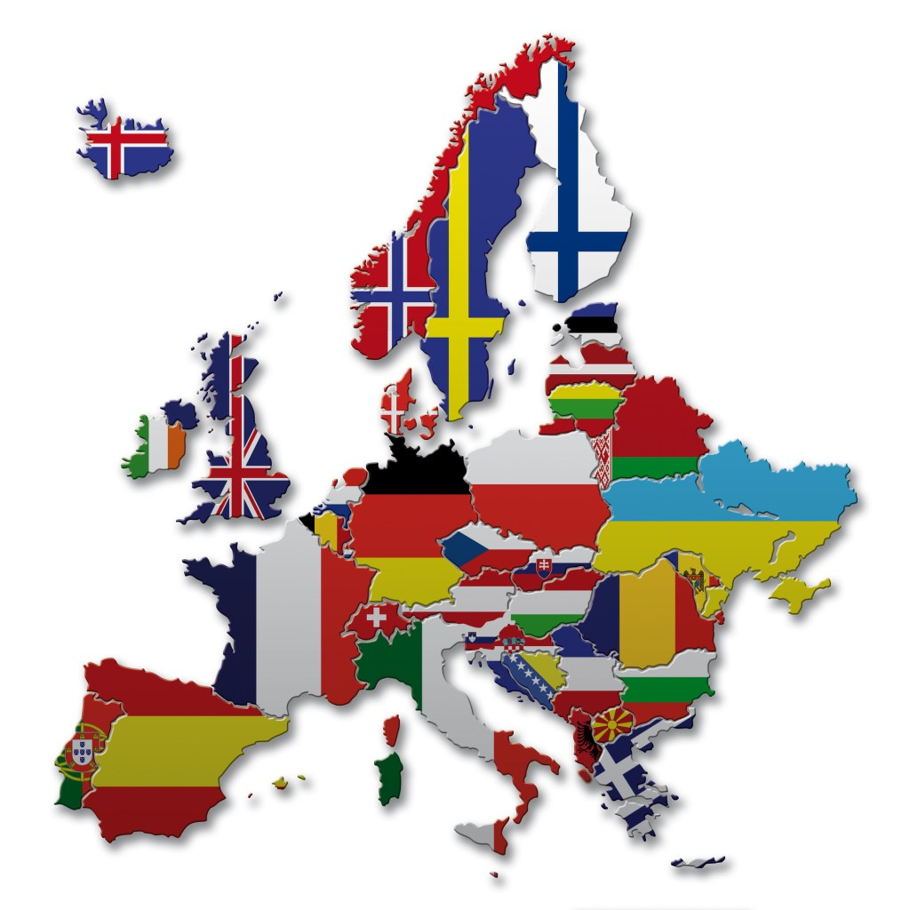

European Language Day
On the 26th September it is European Language Day.
The EU celebrates the richness of its languages and cultures through the European Day of Languages. This day is an opportunity for people, schools and organisations across Europe to recognise the importance of multilingualism and to discover the fun of learning new languages.
There are more than 6000 languages spoken around the world!
Twenty Four of the EU languages spoken include: Bulgarian, Croatian, Czech, Danish, Dutch, English, Estonian, Finnish, French, German, Greek, Hungarian, Irish, Italian, Latvian, Lithuanian, Maltese, Polish, Portuguese, Romanian, Slovak, Slovene, Spanish and Swedish.

Slide 2
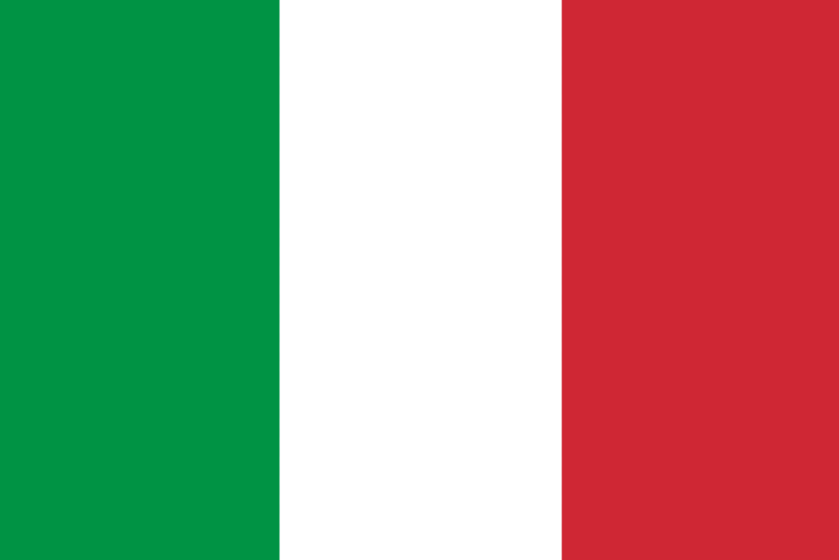
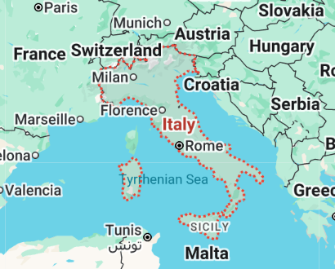
September - Italian
Language of the month
Italian is mainly spoken in Italy, but is also an official language in San Marino, Switzerland and Vaticon City. Significant Italian-speaking communities exist worldwide, particularly in countries like the United States, Argentina, and Australia, which are home to Italian immigrant and expatriate populations.

Slide 3

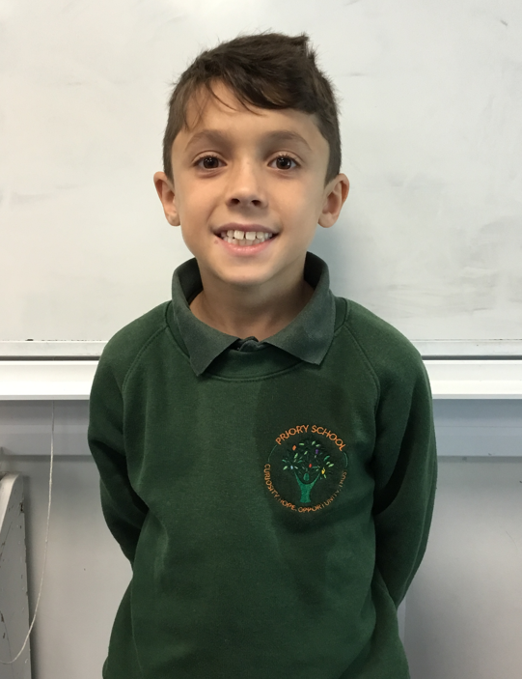
I can speak Italian, English and French.
My name is Valentino and my dad is from Italy, and my mum is from France.
I went to Italy in the Summer and loved it when we went go karting.
September - Italian
Language of the month
I love to eat lots of pasta!

Slide 4
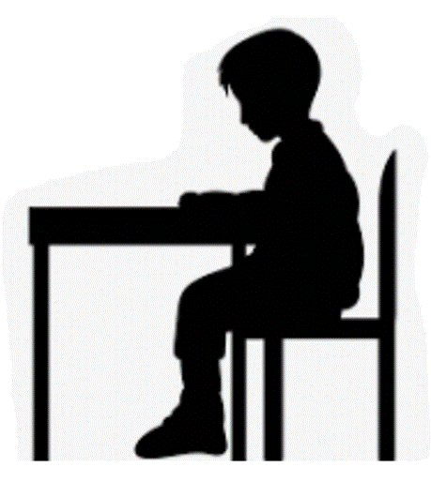
Il registro - The Register
Buon pomeriggio
Signora.
Buon pomeriggio
Signore.
Italian | English
Buongiorno | Good morning
Signora | Madam
Signore | Sir
Buon pomeriggio | Good afternoon
Ciao | Hello
September - Italian
Burongiorno Signora.
Language of the month
Burongiorno Signore.

Slide 5
Colori – Colours
blu
rosso
giallo
September - Italian
Language of the month
verde
arancia
Introduction to colours: https://youtu.be/qiAsZY69HMI
Visuals and colours: https://www.youtube.com/watch?v=umTNpZLK8yA

Slide 6

Pranzo – Lunch
Verde grazie.
Arancia per favore.
Quale colore?
Giallo per favore.
September - Italian
Language of the month
Blu grazie.
Italian | English
per favore | please
Grazie | thank you
Quale colore? | Which colour?
Rosso grazie.

Slide 7
Good morning
Buongiorno
Thank you
Grazie
Yes
SÌ
Please
Per favore
Hello
Ciao
Sorry
Scusa
Well done Ben fatto
September - Italian
Language of the month
Good afternoon
Buon pomeriggio
Goodbye
Arrivederci
No
NO

Slide 8

One
uno
Three
tre
Five
cinque
Two
due
Four
quattro
September - Italian
Six
sei
Eight
otto
Language of the month
Ten
diece
Seven
sette
Nine
nove
Numbers song: https://www.youtube.com/watch?v=8JsdiTiowGM

Slide 9
Useful websites:
Facts:
https://www.kids-world-travel-guide.com/italy-facts.html
https://kids.nationalgeographic.com/geography/countries/article/italy
One of Italy’s most famous composers was Antonio Vivaldi – he was one of the first to describe places, feelings and images using music. Here’s a link to a video with music and information about “Winter” from the 4 Seasons: https://www.youtube.com/watch?v=ixxEbheyvfg
A very famous Italian musician is the singer Andrea Bocelli. Here he is, singing in Italian the song Nessun Dorma from an opera by Puccini. Both Puccini and opera itself came from Italy! https://www.youtube.com/watch?v=2SZsxTBCzoA
September - Italian
Language of the month

