Slide 1

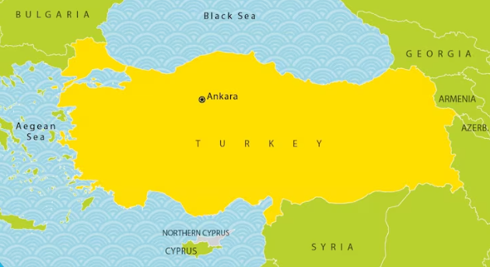

October - Turkish
Language of the month
Turkish (Türkçe) is the most widely spoken of the Turkic languages with around 90 million speakers. It is the national language of Turkey and one of two official languages of Cyprus. Significant smaller groups of Turkish speakers also exist in Germany, Austria, Bulgaria, North Macedonia, Greece, other parts of Europe, the South Caucasus, and some parts of Central Asia, Iraq, and Syria. Turkish is the 18th-most spoken language in the world.

Slide 2


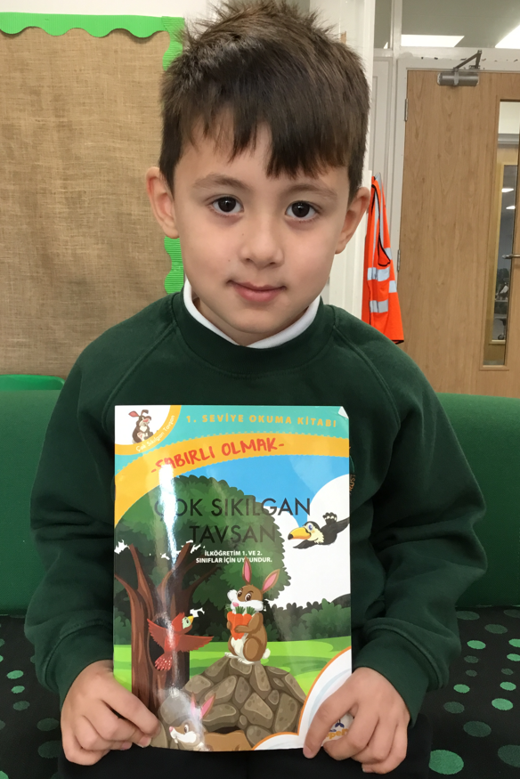
I can speak Turkish and English.
My name is Eymen.
I went to Turkey and I like to swim.
October - Turkish
Language of the month
I love to eat fish!
Eymen shared a book from home, written in Turkish.

Slide 3

Kayıt - The Register
Günaydın
Hanımefendi
Tünaydın
Sayın.
Turkish | English
Günaydın | Good morning
Hanımefendi | Madam
Sayın | Sir
Tünaydın | Good afternoon
Merhaba | Hello
October - Turkish
Tünaydın
Hanımefendi
Language of the month
Günaydın
Sayın

Slide 4
Renkler – Colours
mavi
kırmızı
sarı
October - Turkish
Language of the month
yeşil
turuncu
Introduction to colours: https://www.youtube.com/watch?v=wrnufRPlRO0

Slide 5
Öğle yemeği – Lunch
Yeşil Teşekkür ederim
Turuncu lütfen.
Hangi renk?
Sarı lütfen.
October - Turkish
Language of the month
Mavi Teşekkür ederim
Turkish | English
Lütfen | please
Teşekkür ederim | thank you
Hangi renk? | Which colour?
paketlenmiş öğle yemeği | packed lunch
Kırmızı lütfen.

Slide 6
Good morning
Günaydın
Thank you
Teşekkür ederim
Yes
Evet
Please
Lütfen
Hello
Merhaba
Sorry
Üzgünüm
Well done Tebrikler
October - Turkish
Language of the month
Good afternoon
Tünaydın
Goodbye
Güle güle
No
HAYIR

Slide 7

One
bir
Three
üç
Five
beş
Two
iki
Four
dört
October - Turkish
Six
altı
Eight
sekiz
Language of the month
Ten
on
Seven
Yedi
Nine
dokuz

Slide 8
Useful websites:
Facts:
https://www.kids-world-travel-guide.com/turkey-facts.html
https://kids.nationalgeographic.com/geography/countries/article/turkey
One of Turkey's most famous and prominent composers is Ahmet Adnan Saygun (1907-1991), known as "the grand old man of Turkish music" for his significant contributions to establishing a unique classical music tradition that synthesized Western elements with rich Turkish folk music: https://www.youtube.com/watch?v=n9vxxsRf9t8&t=257s
A current famous Turkish singer is Sezen Aksu. Nicknamed the "Queen of Turkish Pop," she is a legendary singer-songwriter whose influence spans decades, having sold over 40 million albums. https://www.youtube.com/watch?v=rYJjgfCfBOU
October - Turkish
Language of the month

