Slide 1
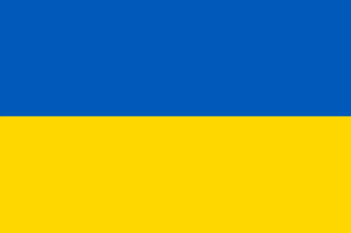
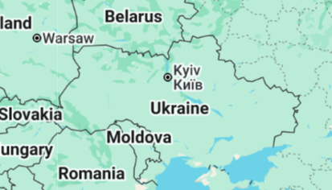

November - Ukrainian
Language of the month
Ukrainian is spoken mostly in Ukraine, where it is the official language and is used regularly by the vast majority of the population. It is also spoken by communities in neighboring countries such as Poland, Romania, Slovakia, and Moldova, as well as in countries with large Ukrainian populations like the United States, Canada, and Brazil.

Slide 2

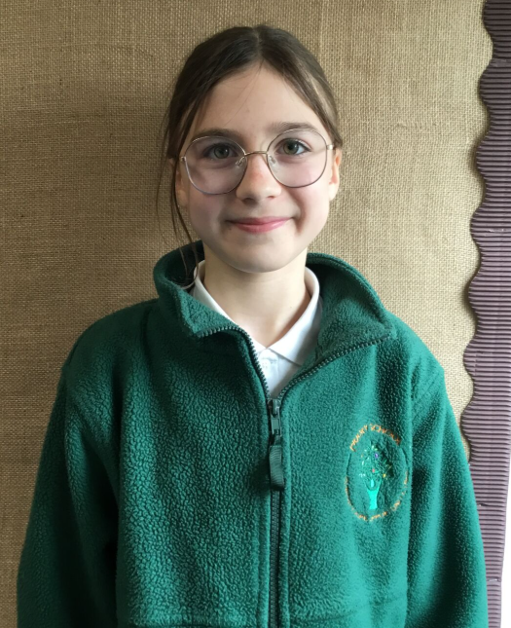
I can speak Ukrainian and English.
YA mozhu rozmovlyaty ukrayinsʹkoyu ta anhliysʹkoyu movamy.
My name is Melaniia.
Mene zvaty Milaniya.
November - Ukrainian
Language of the month
I enjoy spending time with my friends.
Meni podobayetʹsya provodyty chas z druzyamy.
I love to eat borch.
YA lyublyu yisty borshch.

Slide 3
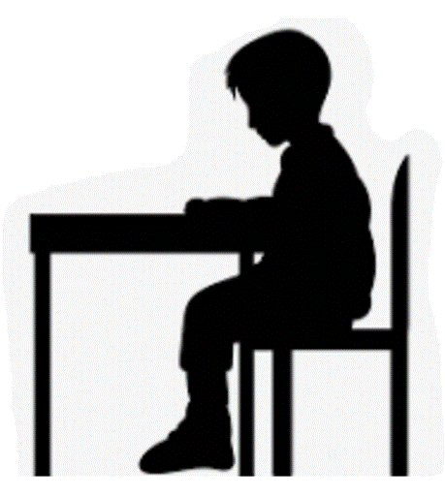
Pеєстр (reyestr) - The Register
Dobroho ranku Madam
Dobroho dnya Ser
Ukrainian | English
доброго ранку Dobroho ranku | Good morning
Мадам Madam | Madam
Cер Ser | Sir
доброго дня Dobroho dnya | Good afternoon
Привіт Pryvit | Hello
November - Ukrainian
Dobroho ranku Ser
Language of the month
Dobroho dnya Madam

Slide 4
Кольори (Kolʹory) – Colours
блакитний
blakytnyy
Червоний
Chervonyy
жовтий
zhovtyy
November - Ukrainian
Language of the month
зелений
zelenyy
помаранчевий
pomaranchevyy
Introduction to colours: https://www.youtube.com/watch?v=qTGfq0Qyyiw&t=25s

Slide 5
Обід (obid) – Lunch
зелений дякую
zelenyy dyakuyu
Який колір?
Yakyy kolir?
помаранчевий дякую
pomaranchevyy dyakuyu
жовтий, будь ласка
zhovtyy, budʹ laska
November - Ukrainian
Language of the month
Turkish | English
будь ласка budʹ laska | please
дякую dyakuyu | thank you
Який колір? Yakyy kolir? | Which colour?
запакований ланч zapakovanyy lanch | packed lunch
синій дякую
syniy dyakuyu
червоний дякую
chervonyy dyakuyu

Slide 6
Good morning
доброго ранку
dobroho ranku
Thank you
дякую
dyakuyu
Yes
так
tak
Please
будь ласка
budʹ laska
Hello
привіт
pryvit
Sorry
вибачте
vybachte
Well done молодець
molodetsʹ
November - Ukrainian
Language of the month
Good afternoon
доброго дня
dobroho dnya
Goodbye
до побачення
do pobachennya
No
немає
nemaye

Slide 7

One
один
odyn
Three
три
try
Five
п'ять
p'yatʹ
Two
два
dva
Four
чотири
chotyry
Six
шість
shistʹ
November - Ukrainian
Eight
вісім
visim
Language of the month
Ten
десять
desyatʹ
Seven
сім
sim
Nine
дев'ять
dev'yatʹ
Numbers 1-10: https://www.youtube.com/watch?v=w3brTs4JDAY

Slide 8
Useful websites:
Facts:
https://www.kids-world-travel-guide.com/ukraine-for-kids.html
https://kids.nationalgeographic.com/geography/countries/article/ukraine
Valentyn Vasylyovych Sylvestrov is a Ukrainian composer and pianist, who plays and writes contemporary classical music: https://www.youtube.com/watch?v=fljzRY24vxU
Chervona Ruta (translated from Ukrainian as "Red Rue") is one of the most iconic Ukrainian songs, known worldwide as Ukraine's unofficial national anthem:
https://www.youtube.com/watch?v=TM-bZs-_2I8
November - Ukrainian
Language of the month

