Slide 1
Summary of Pupil Premium Provision
Reception | Year 1 | Year 2 | Year 3 | Year 4 | Year 5 | Year 6
Language Interventions Daily basic skills interventions Sensory Group SALT Behaviour support Fine motor skills Phonics social communication | Daily catch up phonics and reading S+L with JC OWL referral Adult support in class 1:1 support per EHCP Woodlands provision Weekly reading Daily Reading ELSA Tuition | Small group work with an adult Differentiated class work Daily OT with LSA SALT with JC Additional reading Focus child Reward chart Tuition Learning Mentor | Art Talk Behaviour Plan Learning Mentor support SEMH support in year group Focus child in class Additional reading support Phonics catch up Canine Assisted learning | Handwriting support Differentiated spellings ELSA referral Memory group Differentiated class work Art Therapy Sensory group SALT Writing focus group in class TA check ins Adult support in class Additional reading Personalised support per EHCP ELSA Maths intervention Tuition Learning Mentor | Personalised support per EHCP Additional reading support Focus child Handwriting Learning mentor support Spelling support Year group SEMH support Homework club ELSA Boys engagement group Additional small group support Lego club Tuition | Maths Intervention Additional adult support in class Focus child Vocabulary work Spelling support Personalised support per EHCP Additional reading Learning mentor support Financial support Woodlands pupil Personalised support per EHCP Art drop in Mindfullness Tuition

Slide 2
Tuition
All pupil premium pupils in Y1 had phonics tuition
All pupil premium pupils in Y2 and Y3 had reading tuition
Almost all pupil premium pupils in KS2 were offered tuition in reading, writing and/or maths

Slide 3
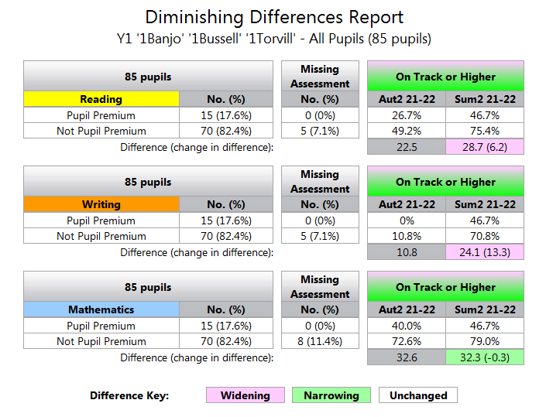
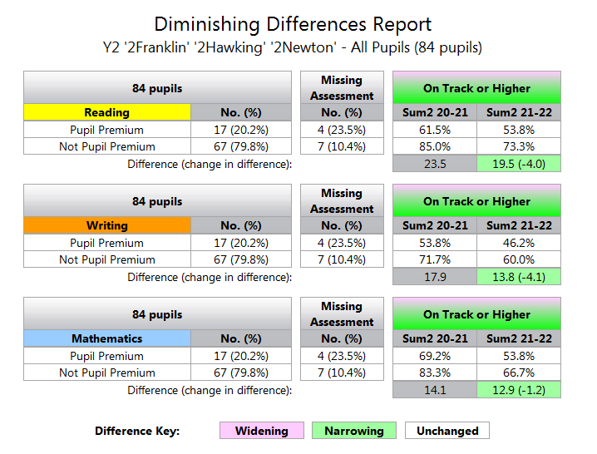
KS1 Pupil Premium Attainment
In Y2, the attainment gap has narrowed in reading, writing and maths.
In Y1, the attainment gap is narrowing slightly in maths but has widened in reading and writing.

Slide 4
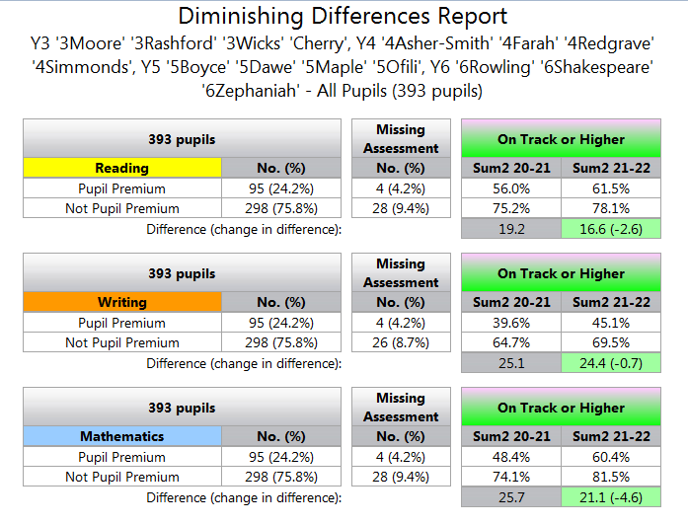
KS2 Pupil Premium Attainment
In KS2, the attainment gap has narrowed in reading, writing and maths.

Slide 5
Y6 Progress
Sum2 2020 – Sum 2 2021
Gap R -24.7 W -21.9 M -15.1
Gap R -1.3 W -5.3 M -3
The gap in progress has narrowed significantly and pupil premium children have made progress this academic year which is broadly in line with their non pupil premium peers.

Slide 6
Y5 Progress
Gap R -13 W -21.6 M -7.3
Gap R -6.3 W -5 M -9.6
The gap in progress has narrowed significantly in reading and writing and in writing, pupil premium children have made progress this academic year which is broadly in line with their non pupil premium peers. The progress gap has widened slightly in maths.

Slide 7
Y4 Progress
Gap R -1.5 W -2 M -0.2
Gap R -10.6 W -16.6 M -10.5
The gap in progress has increased in reading, writing and maths.

Slide 8
Y3 Progress
Gap R -18.8 W -28 M -20.5
Gap R +9.8 W +4.2 M +9.8
The gap in progress has been reversed with more pupil premium pupils making 6+ steps of progress than their peers.

Slide 9
Y2 Progress
Aut 2 2020 – Sum 2 2021
Gap R -30.4 W -52.5 M -11.3
Aut 2 2021 – Sum 2 2022
Gap R -4.2 W +1.9 M -19
The gap in reading progress has been significantly narrowed and the progress gap in writing has been reversed with more pupil premium pupils making 4+ steps of progress than their peers. The progress gap has widened in maths.

Slide 10
Y1 Progress
Aut 2 2021 – Sum 2 2022
Gap R -7.1 W +8.6 M +8.1
A higher percentage of Pupil Premium pupils have made 4+ steps of progress in writing and maths than their non pupil premium peers.

