Slide 1
Year 3 and 4 Parent forum

Slide 2
The general themes
Staffing in Year 3
Including the health and wellbeing of staff
Exclusion periods after absence
For example sickness bugs
Latest performance data is below average
Including league tables
What should parents do if their child is behind
What books or practice do teachers recommend
Help with times tables

Slide 3
The general themes
Measuring progress of children with SEND
Use of IEPs
How to help children at home
Communication
Ensuring incidents are passed on to parents
Wellbeing and environment for pupils
Pupil welfare, wellbeing and safety
Supporting with times tables
Supporting vocabulary development
Ensuring all staff know the children with SEN
Support for new pupils

Slide 4
Staffing – the issues
Staffing in schools is a problem – not specific to Priory
Recent strikes are indicative of the issue – shortage of teachers, increase in teachers leaving the profession, lack of teachers applying for roles
Budget reductions
Increase in long term absence due to health needs – NHS waiting times and stretched services are not helping

Slide 5
Workable Solutions
Wellbeing
86% of staff feel that the leadership team maintain a manageable workload.
Cover
Curriculum
High quality planning is in place
77% feel that senior leadership consider workload when making decisions.
90% of staff feel that wellbeing is important to staff.
We have reduced work load since being here – marking, assessment, paperwork.
Consult with staff before changes are made, take on board their feedback.
Whole school events boost morale, staff nights, weekly bulletin
Invested in two cover supervisors
Use Higher Level Teaching Assistants to cover
We carefully consider how we cover classes to ensure consistency and that they have someone who knows them
We only keep supply if they are good
SENCOs still oversee provisions and support in place
Year leaders offer consistency – when year leader is absent – we find someone to cover that role as it is critical in ensuring continuity.
Year leader will ensure a continuity of curriculum delivery
Timetables, structures and routines are established and consistent across the school.
We have a teaching and learning vision in place to ensure pupils receive the best teaching.

Slide 6
Exclusion Periods
We generally use the NHS guidance to advise parents
Sickness is always slightly tricky because it depends on the reason for the sickness- 24-48 hours for a bug but less for anything else.
https://www.gov.uk/government/publications/health-protection-in-schools-and-other-childcare-facilities/children-and-young-people-settings-tools-and-resources

Slide 7
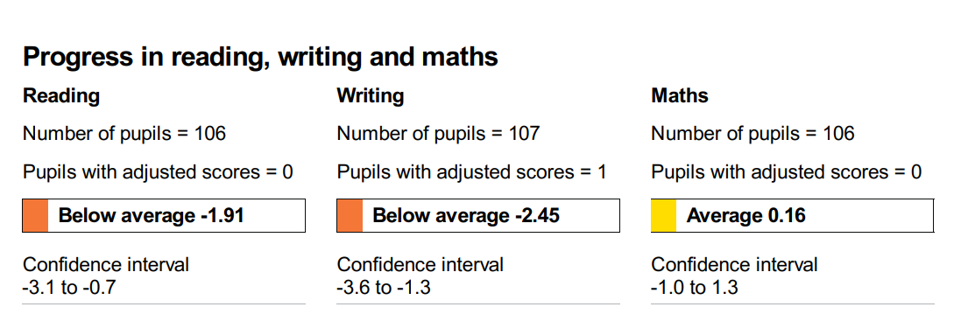
Latest performance data
This is our published data
This data includes all our pupils
We have a SEND unit and a resource base so our numbers of children who are unable to sit the SATs are very high – 12 % of our cohort were dis-applied from the SATs. Meaning our highest possible % could have been 82
However, 30% of our year 6 cohort had SEND

Slide 8
When we look at it a different way
Without the dis-applied group, our data looks a lot healthier and more in line with other schools – other schools do not have as many dis-applied children as we do.
Writing remains a priority and is on the School Development Plan – can be found on the website
Since 2019 improvements are noticeable despite increasing SEND and covid:
3% increase on 2019 in reading
2% drop in writing – this is a focus and impacted heavily by covid
5% increase in maths from 2019
In 2023 – 25% of our children went to Grammar Schools (1:4 but 1:20 all children)
 | Number on roll in Yr 6 | % of SEN | % of EHCPs | Resource Base and mainstream makeup | Reading | Writing | Maths | Combined
2019 data and Contextual information | 137 | 22% | 9% | 8 in Orchard | 65% | 64% | 65% | 53%
2022 data and contextual information | 100 | 30% | 14% | 9 in Orchard 5 EHCPs in mainstream | 63% | 48% | 53% | 41%
2023 data and contextual information | 117 | 28% | 11% | 3 in Orchard and 6 in Woodlands 4 in mainstream | 68% | 62% | 70% | 54%
 | +17 | - 2% | -3% |  | +5% | +14% | +17% | +13%

Slide 9
School priorities quality of education
We must continue to focus on improving outcomes for pupils at each key stage through the delivery of a strong curriculum and good teaching.
We will build on the principles of our approaches to reading and writing so that all children make sufficient progress to enable them to access the whole curriculum meaningfully
To ensure a strong start for our youngest pupils through the delivery of a strong curriculum, targeted teaching and an inclusive environment.

Slide 10
Objectives
To ensure a sufficiently ambitious and inclusive diverse curriculum to ensure all pupils in our community are represented
Teachers identify and address gaps in learning to ensure that all pupils but particularly those identified as DAP acquire core knowledge and skills which allows them to progress through the curriculum.
To ensure children access a robust, engaging and relevant computing curriculum
To provide children with opportunities to write independently at length and depth across the curriculum.
Build on the implementation of our SSP to ensure progress of reading in KS1 is accelerated
Teachers will focus on adopting strategies that will engage boys in reading across the full breadth of the curriculum so that engagement and participation improves
The EYFS environment will excite curiosity and engagement through purposeful and child initiated play that will promote a love for reading and communication
Teachers will deliver high quality phonics and reading sessions to ensure that all children acquire the skills they need to progress in reading in the EYFS

Slide 11
Behaviour and Attitudes
We continue to build on good behaviour principles through implementing our updated behaviour policy to ensure all groups of children can access their learning.
The school will ensure that policy and processes are relentlessly followed to tackle poor attendance and reduce persistent absence.

Slide 12
objectives
To continue to develop staff understanding of the principles that under pin our behaviour approach to ensure a consistent and effective approach to behaviour.
Through staff training we will focus on improving the engagement of boys in class, tackling low level disruption and improving boys behaviours for learning,
To improve pupil punctuality and attendance by having clear policies and procedures that engage all stakeholders in the journey to improve attendance

Slide 13
Personal Development
To ensure the positive representation of our school community
Leadership and management
To have robust systems in place to enable staff to work effectively and efficiently in a positive and safe environment for all stakeholders

Slide 14
Measuring progress of children with SEND
IEPs Vs Provision maps

Slide 15
Keeping Updated!
The Y3 and Y4 class pages on the school website are a great place to find additional information such as:
Welcome Meeting powerpoint (held at the beginning of every year)
Communication
Peek at the Week
Homework and helping your child at home
Curriculum information
Information about trips
Information about Y4 MTC
Events – photos
Children’s work
www.prioryschool.co.uk
Notes:
Michelle

