Slide 1
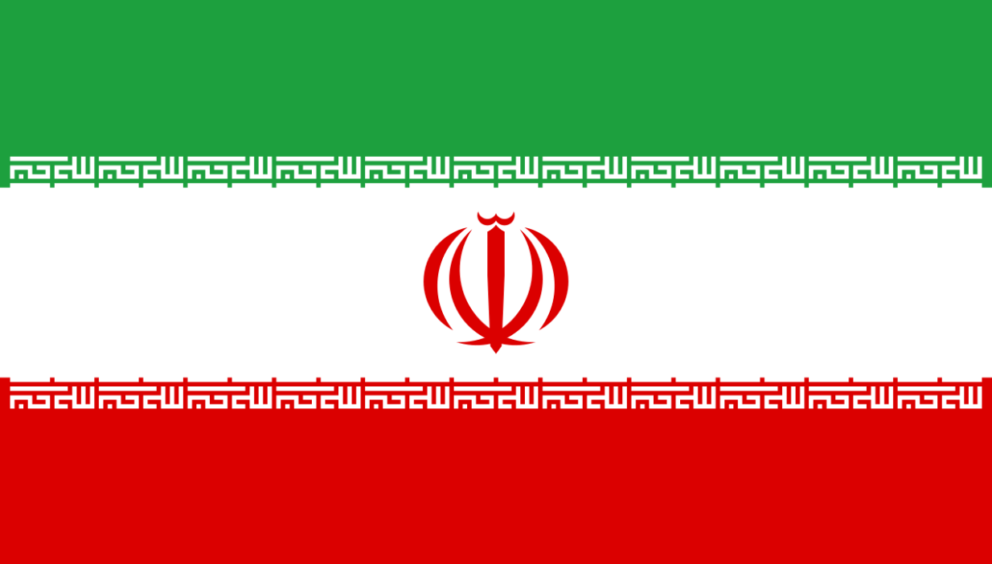
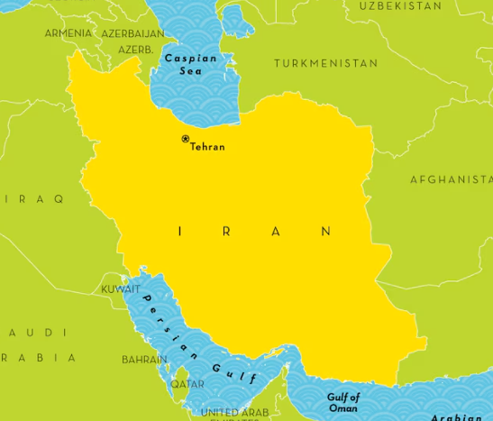

Language of the month
December - Farsi
Farsi is the official language and most widely spoken in Iran. Farsi also has official status in Afghanistan (as Dari) and Tajikistan (as Tajik). Significant populations of Farsi speakers can also be found in other Persian Gulf countries, such as Bahrain, Iraq, Oman, the United Arab Emirates, and Yemen.
Farsi and Persian are the same language, but "Persian" is the term most often used in English to refer to the language as a whole, while "Farsi" is the term used by native speakers in Iran.

Slide 2

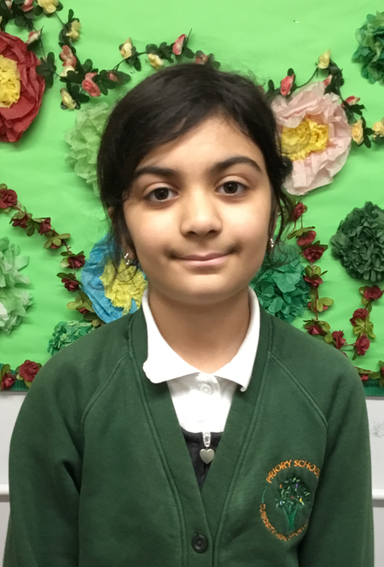
I can speak Farsi.
man mitavanam farsi.
My name is Bareen.
nam man Bareen est.
December - Farsi
Language of the month
I like doing Maths.
man az enjam dadan riyazi khosham miyad.
I eat kebabs!
man meheramn kebabs!

Slide 3
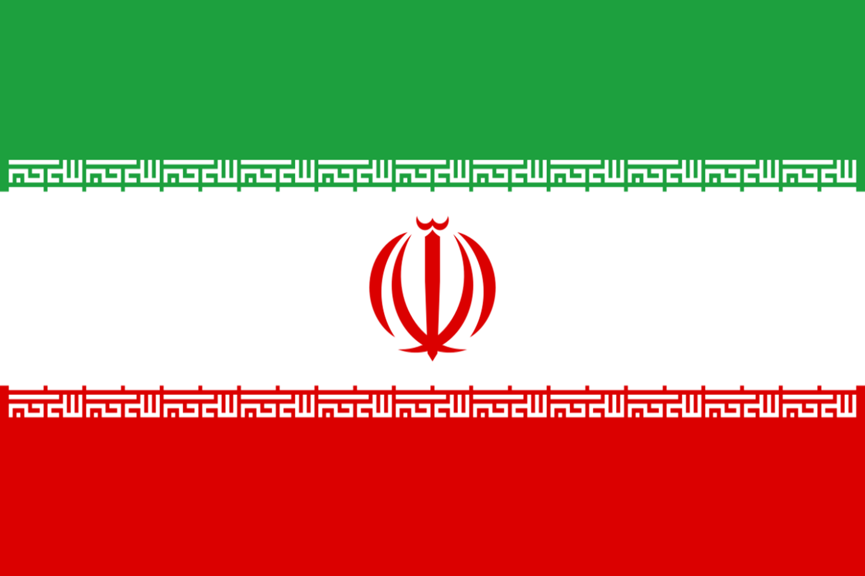

ثبت نام sabat nam - The Register
صبح بخیر خانم
sobh bakhir khanam
ظهر بخیر آقا
zanpar bakhir aga
Farsi | English
صبح بخیر sobh bakhir | Good morning
خانم khanam | Madam
آقا aga | Sir
ظهر بخیر zanpar bakhir | Good afternoon
سلام salam | Hello
December - Farsi
صبح بخیر آقا
zanpar bahkir khanam
Language of the month
صبح بخیر آقا
sobh bakhir aga

Slide 4
رنگا rang – Colours
آبی
obi
قرمز
surhk
زرد
zard
December - Farsi
Language of the month
سبز
sabz
نارنجی
naranji
Introduction to colours: https://www.youtube.com/watch?v=PoIbrlMJllM

Slide 5
ناهار Nanpehar – Lunch
سبز لطفا
sabz lotfa
کدوم رنگ
kodom rang
نارنجی ممنون
naranji shukhr
زرد متشکرم
zard lotfa
December - Farsi
Language of the month
Turkish | English
لطفا lotfa | please
شكرً shukhr | thank you
کدوم رنگ kodom rang | Which colour?
ناهار بسته بندی شده nanpehar basteh bandi shodeh | packed lunch
آبی متشکرم
obi shukhr
قرمز لطفا
surhk lotfa

Slide 6
Good morning
صبح بخیر
sobh bakhir
Thank you
شكرً
shukhr
Yes
بله
beleh
Please
لطفا
lotfa
Hello
سلام
salam
Sorry
متاسفم
motesfam
Well done آفرین
afarin
December - Farsi
Language of the month
Good afternoon
ظهر بخیر
zanpar bakhir
Goodbye
خداحافظ
khodahafez
No
نيه
neh

Slide 7

One
یکی
yeki
Three
سه
seh
Five
پنج
panj
Two
دو
do
Four
چهار
chehar
Six
شش
shesh
December - Farsi
Eight
هشت
npasht
Language of the month
Ten
ده
dah
Seven
هفت
npaft
Nine
نه
nah
Numbers 1-10: https://www.youtube.com/watch?v=d0q-L20AIdA

Slide 8
Useful websites:
Facts:
https://www.kids-world-travel-guide.com/iran-facts-for-kids.html
https://kids.nationalgeographic.com/geography/countries/article/iran
Hossein Alizadeh is one of the most important figures in Persian music. He is an Iranian musician, composer, researcher, teacher, setar instrumentalist and improviser: https://www.youtube.com/watch?v=XBNtBDX5XFE
"Morq-e Sahar" (The Bird of Dawn) is considered one of the most iconic and enduring Iranian songs, celebrated for its poetic lyrics, melodic beauty, and profound themes of hope and freedom: https://www.youtube.com/watch?v=Gzn-r2IMPqc
December - Farsi
Language of the month

